Slide 1
A General Survey of ...
英国概况

Slide 2
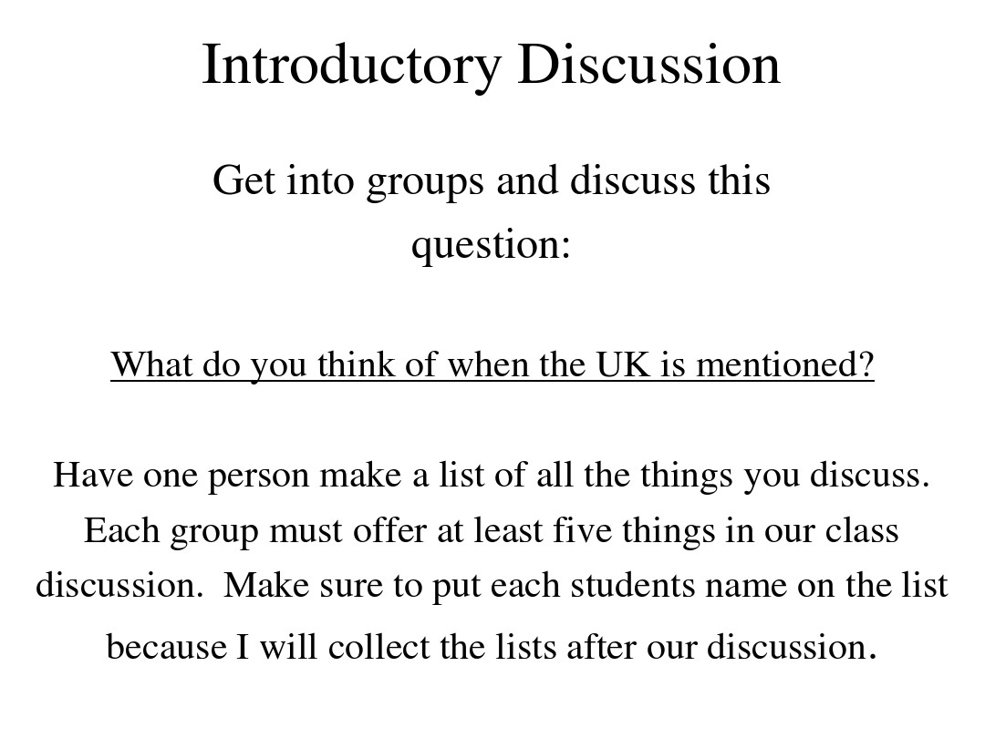

Slide 3
What may pop into your mind when it comes to 英国?
What do you know about 英国？

Slide 4
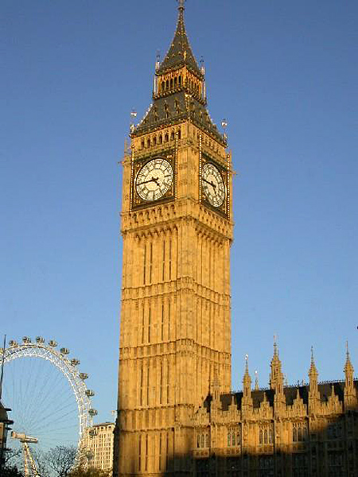
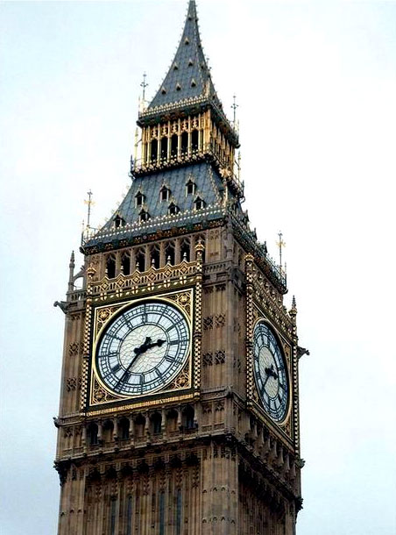
Things that may pop up

Slide 5
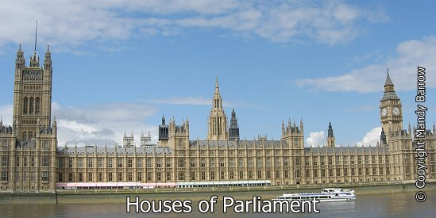
Palace of Westminster

Slide 6
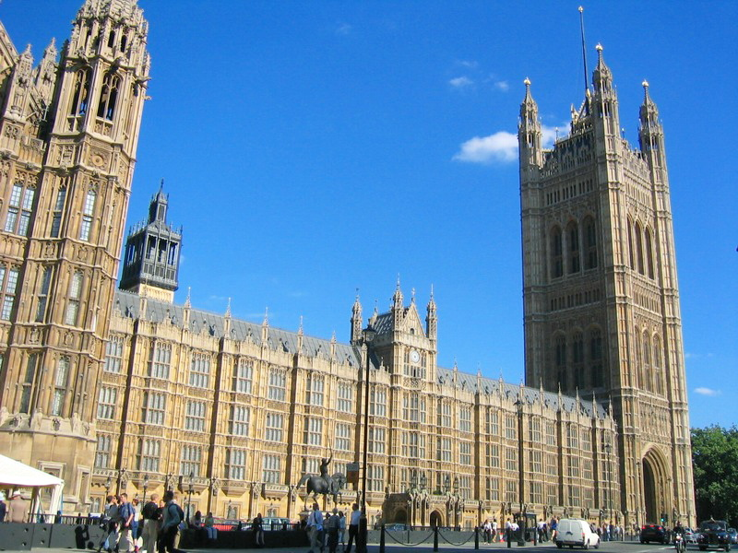
西敏寺/威斯敏斯特教堂
（Westminster abbey）

Slide 7

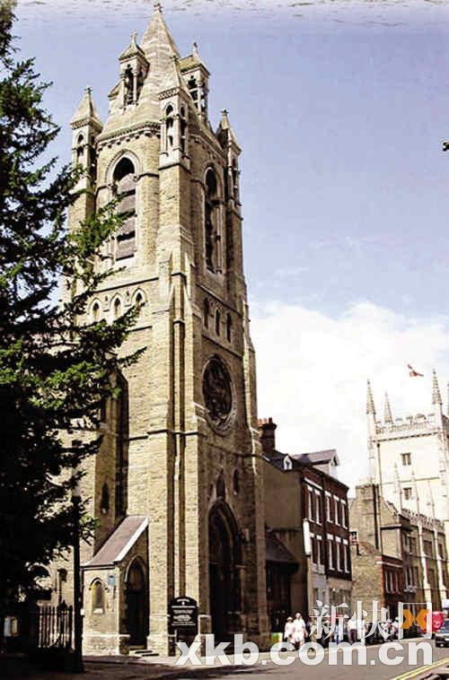
University of Oxford

Slide 8
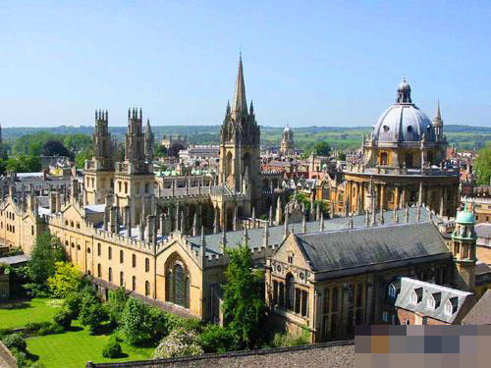
University of Oxford

Slide 9
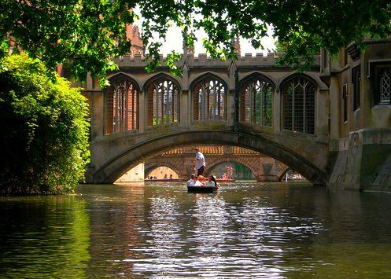
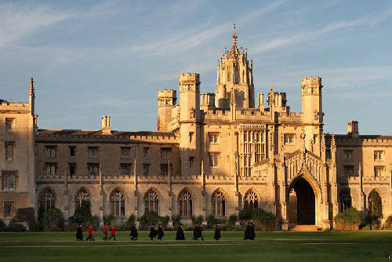
University of Cambridge

Slide 10

Iconic trench coat

Slide 11
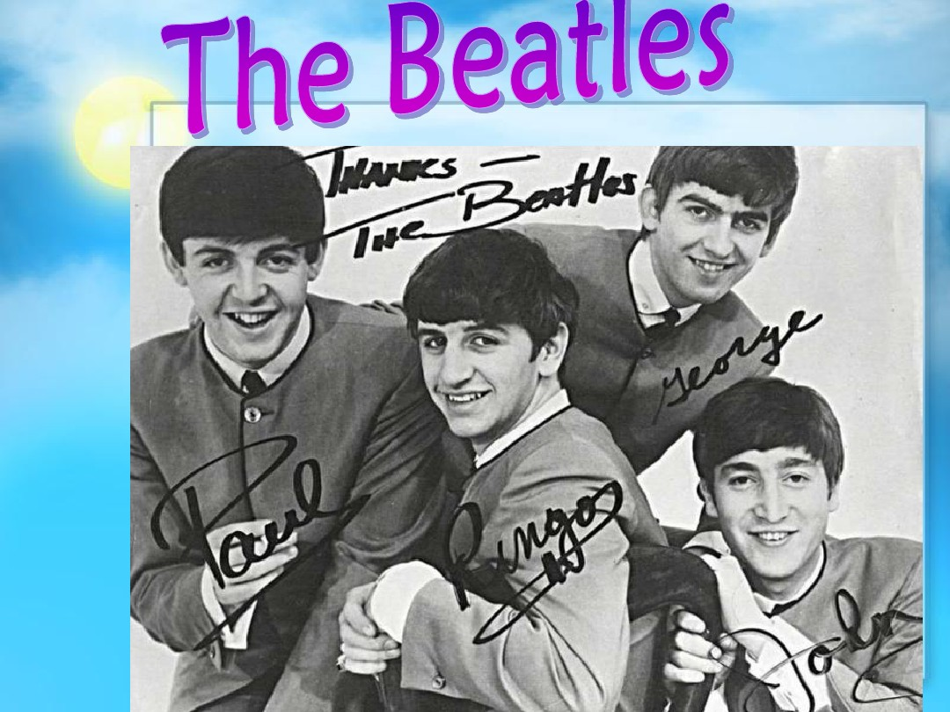
披头士乐队/甲壳虫乐队

Slide 12
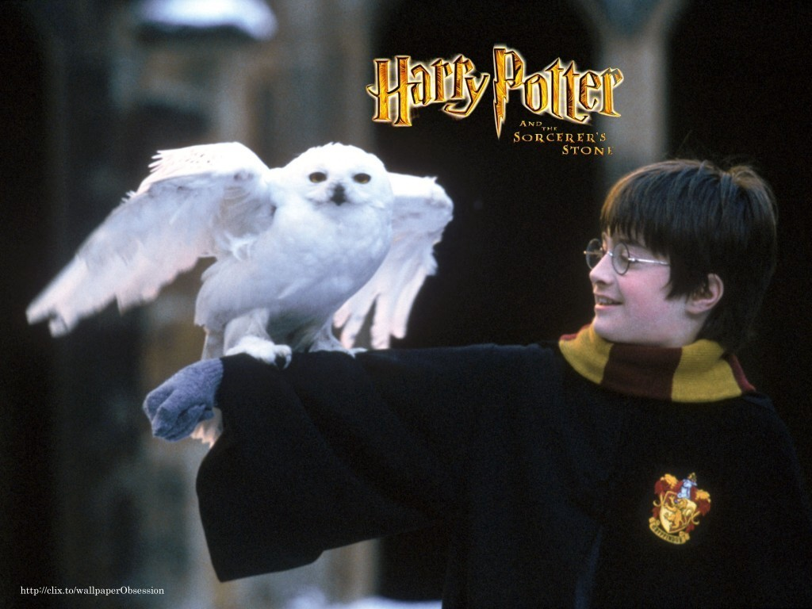

Slide 13
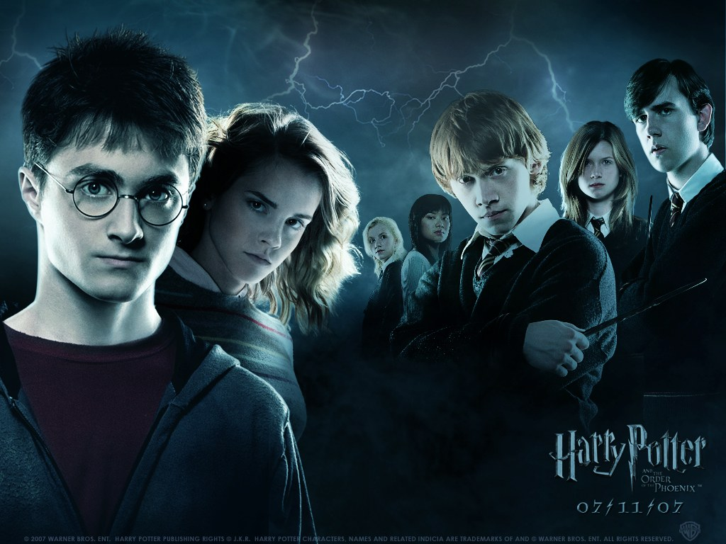

Slide 14
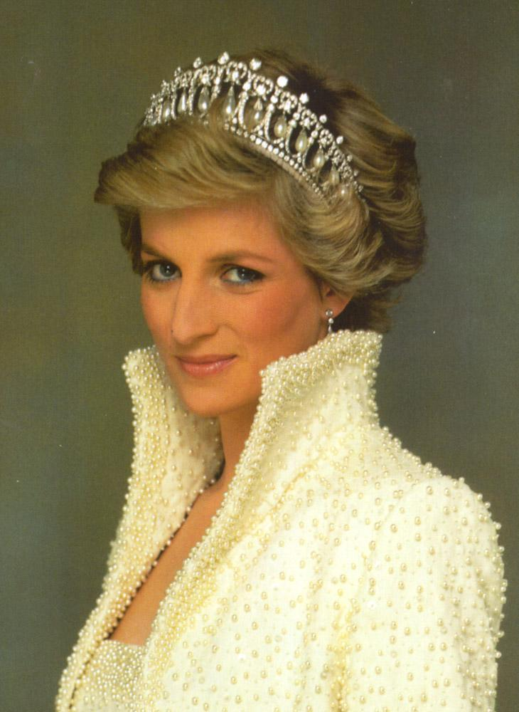

Slide 15
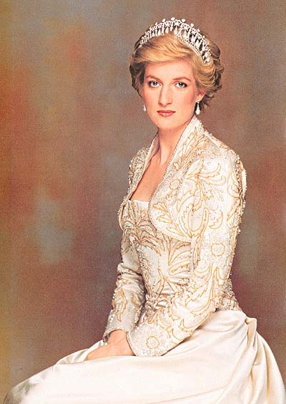
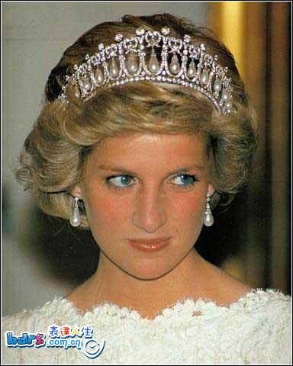

Slide 16
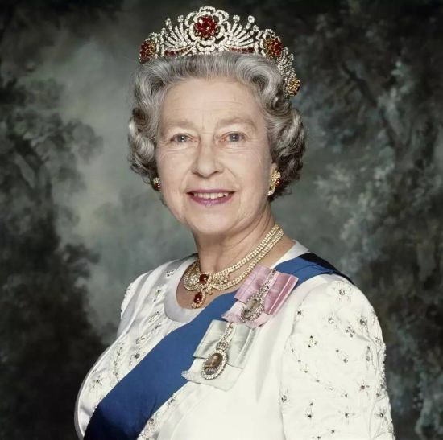

Slide 17

Chapter 1 General Introduction to 英国
The name
The Location
The Physiographical Features
Rivers and Mountains
Climate and weather
Population
The Major Cities

Slide 18
Focus questions
What is the full name of the British state?
What countries does it consist of?
What is the total population of the United Kingdom? Where do most British people live? What is the most densely populated area of Britain? What is the least populated?
What are the major cities in Britain?

Slide 19
Different Names for Britain and its Parts
1. What are the names that come to your mind when people refer to 英国?
(1) Britain
(2) Great Britain
(3) England
(4) The British Isles
(5) The United Kingdom or the U.K.

Slide 20
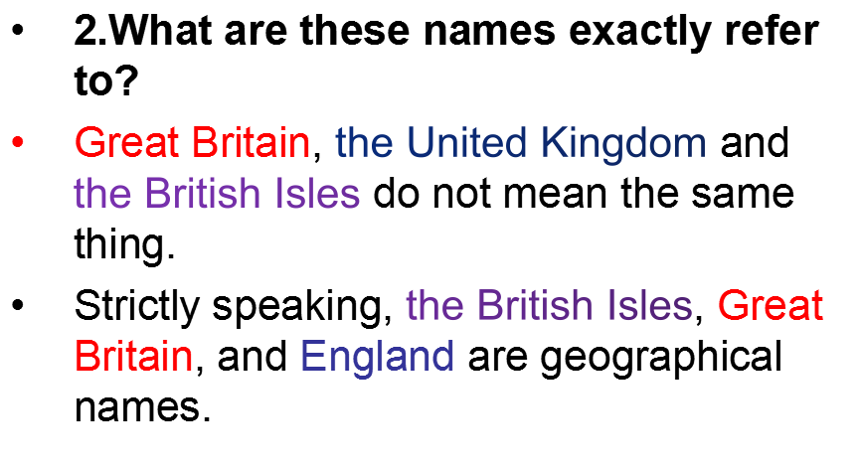

Slide 21
英国、英格兰和不列颠的区别&英联邦殖民地：5M（good） -02:17
https://www.bilibili.com/video/av4970689/?spm_id_from=333.788.videocard.2

Slide 22
英国是怎样一个国家：中文4M
https://www.bilibili.com/video/av13154944/?spm_id_from=333.788.videocard.3
英国皇室：中文4M
https://www.bilibili.com/video/av9196387/?spm_id_from=333.788.videocard.6
英国为什么称“腐国”：中文4M
https://www.bilibili.com/video/av8762206/?spm_id_from=333.788.videocard.9
英国的礼仪：中文4M
https://www.bilibili.com/video/av9506222/?spm_id_from=333.788.videocard.2

Slide 23
Great Britain
England is part of an island called Great Britain, the largest island in Europe. Great Britain is the official name given to the two kingdoms of England and Scotland, and the principality of Wales. It also includes the small adjacent islands except the Channel Islands and the Isle of Man. Sometimes people use the shorten name Britain instead of Great Britain.
The term "Great Britain" was used for the first time when England and Scotland became a single kingdom under King James VI of Scotland who became King James I of England in 1603.

Slide 24
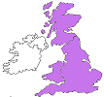
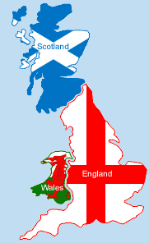
Great Britain
Great Britain is made up of:
England - The capital is London.
Scotland - The capital is Edinburgh .
Wales - The capital is Cardiff.

Slide 25
United Kingdom
The United Kingdom consists of Great Britain - the main island made up of England, Scotland and Wales - and Northern Ireland.
The United Kingdom of Great Britain and Northern Ireland (UK) was formed in on January 1 1801 and constitutes the greater part of the British Isles. The largest of the islands is Great Britain, which comprises England, Scotland and Wales. The next largest is Ireland, comprising Northern Ireland, which is part of the UK, and, in the south, the Irish Republic.

Slide 26
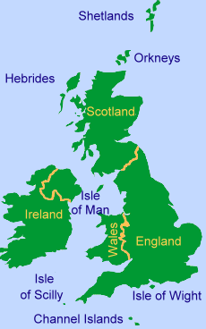
The British Isles
The British Isles include the UK, Great Britain, and other islands such as Ireland and the Channel Islands.
The British Isles consists of:
Great Britain (England, Scotland and Wales)
The whole of Ireland
The Orkney and Shetland Islands
The Isle of Man
The Inner and Outer Hebrides
The Isle of Wight
Scilly Islands
Lundy Island
The Channel Islands
Plus many other offshore islands

Slide 27
The British Isles is made up of:
England - The capital is London.
Scotland - The capital is Edinburgh .
Wales - The capital is Cardiff.
Northern Ireland - The capital is Belfast.
Republic of Ireland - The capital is Dublin.
And about five thousand small islands.

Slide 28
Summary
2 large islands Great Britain England
Scotland
Wales
Northern Ireland
Ireland Republic of Ireland
about five thousand small islands.
British Isles

Slide 29
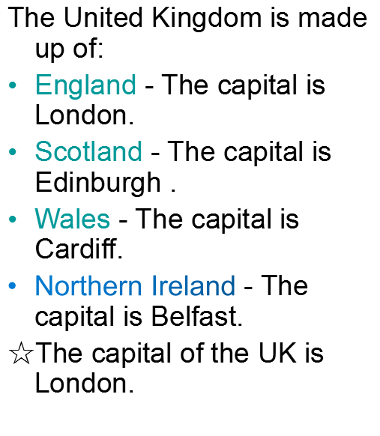
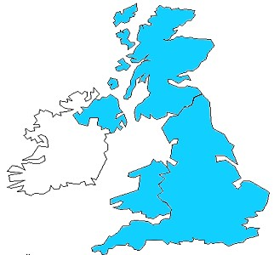
The United Kingdom

Slide 30

Three terms
British Isles
Britain
Great Britain
Two large islands several small ones
The United Kingdom of Great Britain and Northern Ireland.
England, Wales
Scotland

Slide 31
The complicated full name of the UK
The United Kingdom of Great Britain and Northern Ireland
Four parts:
England
Scotland
Wales
Northern Ireland

Slide 32
英国历史（英国为什么分为英格兰，苏格兰，威尔士和北爱尔兰 中文讲解5M good
https://www.bilibili.com/video/av5345746/?spm_id_from=333.788.videocard.4

Slide 33
What is the official name of Britain?
(1) The United Kingdom of Great Britain and Northern Island
(2) For short: Britain, the United Kingdom or U.K.

Slide 34
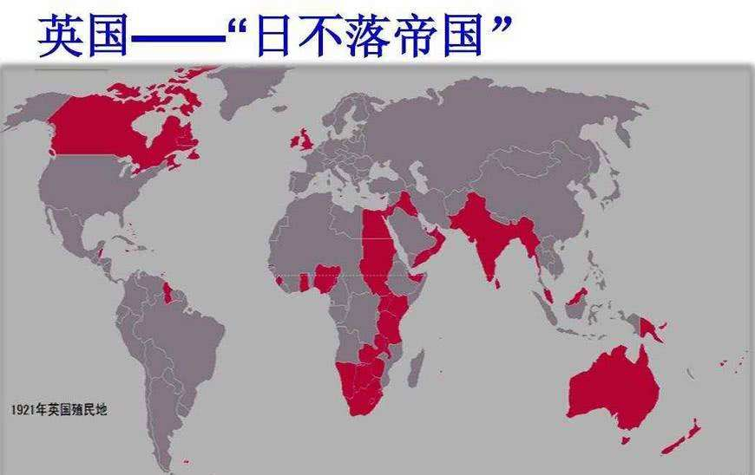
British Empire
02:17
“The sun never sets on the British Empire”
(1) Ruled of the world’s population and
of world’s land
(2) Had colonies in North America, Asia, Africa, Australia
1/4
1/4

Slide 35
英国是世界第一个完成工业革命的国家，凭借船坚炮利，在全球范围内占领了大量殖民地，被称为“日不落帝国”。19世纪时是世界头号强国，那时候英国不仅仅军事强大，在经济，科技，文化诸多方面，都处于世界先进地位Britain was the first in the world to complete the industrial revolution. By virtue of their strong ships and artillery, they have occupied a large number of colonies around the world, known as the "sun never sets Empire". In the 19th century, Britain was the number one power in the world. At that time, Britain was not only powerful in military affairs, but also advanced in economy, technology and culture

Slide 36
British Commonwealth 英联邦(Commonwealth of Nations)
The term ‘Commonwealth’ has been used to replace the word ‘Empire’ to describe collectively the independent countries associated under the British crown
(1) A free association of countries used to be English colonies
(2) 53 member countries at present
(3) Functions: active in a number of areas including development, democracy, debt management and trade.

Slide 37
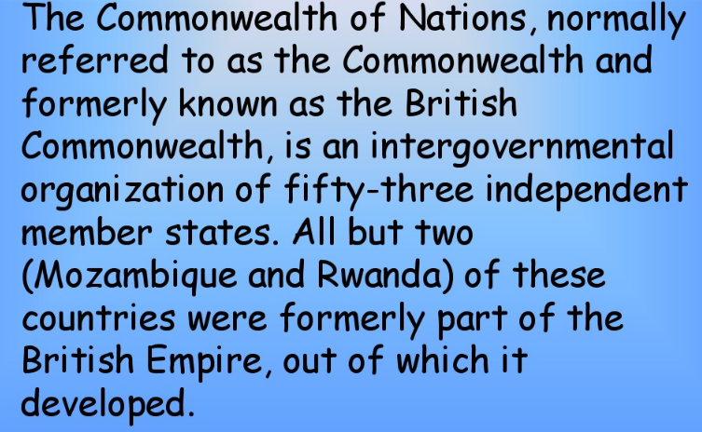

Slide 38
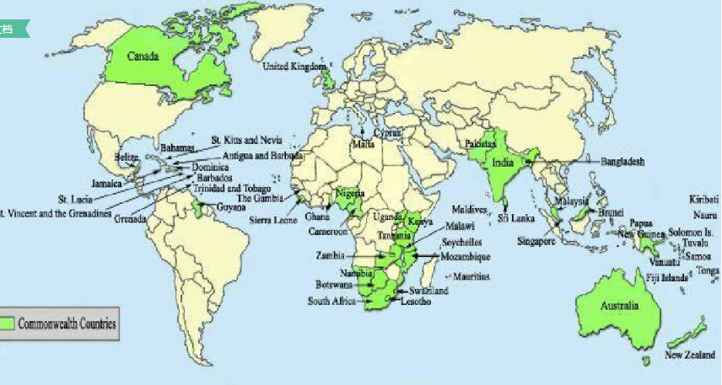

Slide 39
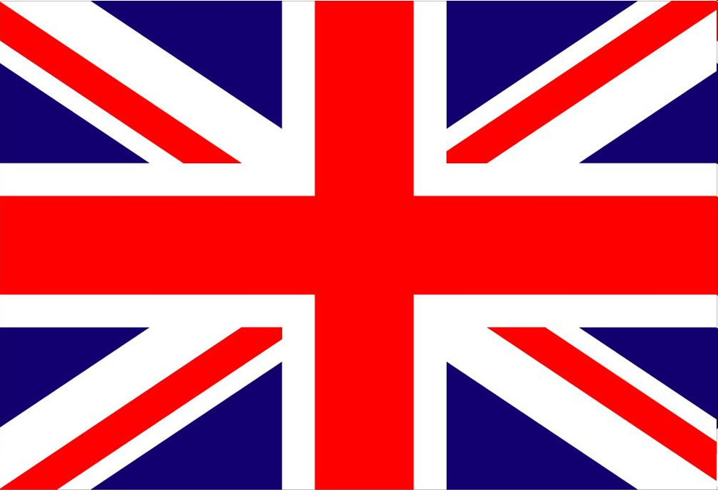
The Union Jack
the union flag or the national flag of the United Kingdom

Slide 40
*The Union Jack
--refers to the union flag or the national flag of the United Kingdom
--It is called the Union Flag because it represents the emblems (象征，标志) of the four countries united under one Sovereign(君主) - the kingdoms of England and Wales, of Scotland and of Ireland.
--Although the name "Union Jack" is the popular name by which the flag is known to the world, it should strictly, perhaps, only be used for the flag when it is flown as a jack (a small flag flown at the bow of a ship); government documents generally prefer "union flag" as the more universally correct term

Slide 41
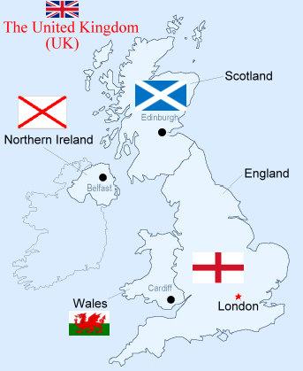
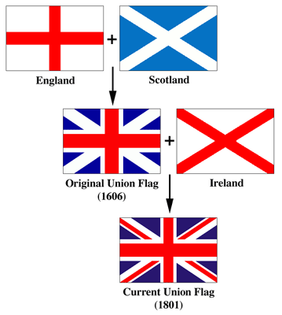
Union Jack/ Union Flag

Slide 42
讲义
It is made up of the individual Flags of three of the Kingdom’s countries all united under one Sovereign-the countries of England, of Scotland and of Northern Ireland. As Wales was not a kingdom but a Principality 公国，侯国it could not be included on the flag.

Slide 43
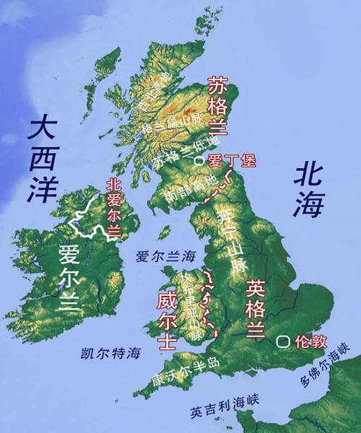
Insular country
12,429 km
The location
of
the
UK
total land area of 244,100 square kilometers

Slide 44
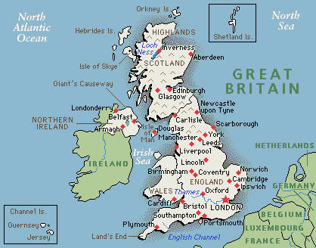

Slide 45
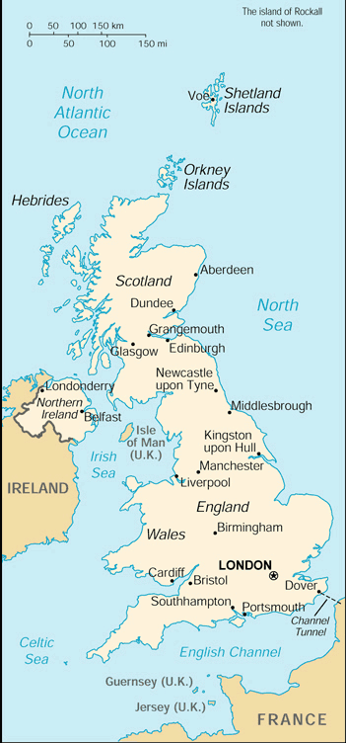
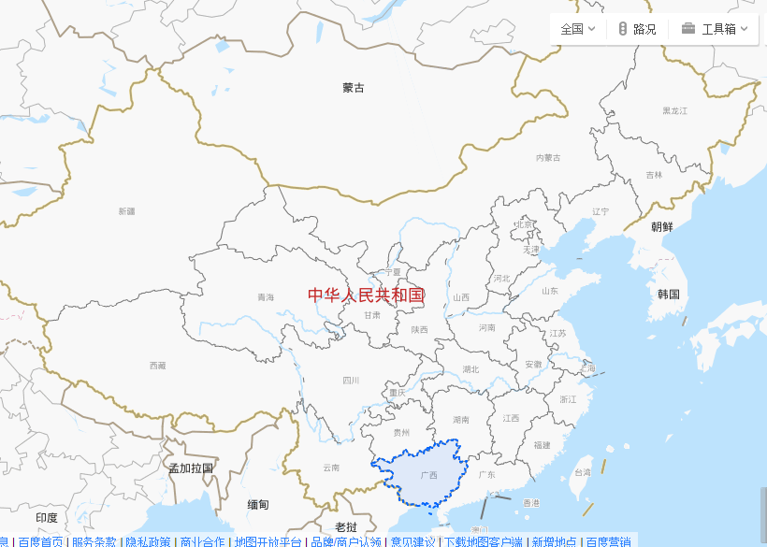
英国 24.41万平方公里
23.67万平方公里
广西省

Slide 46
Insular country
12,429 km
The location
of
the
UK
total land area of 244,100 square kilometers
from north to south: 1000km

Slide 47
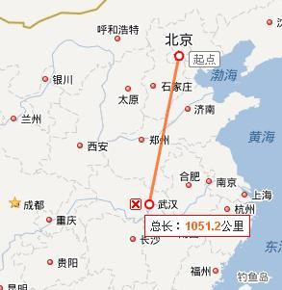

Slide 48
讲义The location of the UK
Britain is situated in western Europe and is separated from the European continent by the North Sea, the Strait of Dover and the English Channel.
It is an insular country. Its coastline runs 12,429 km, It is one of the countries with longest coastline.
It has a total land area of 244,100 square kilometers, of which nearly 99% is land and the remainder inland water. From north to south it is about 1,000 kilometers long.
To the west of it lies the Atlantic Ocean, across and beyond it is America.

Slide 49
The Physiographical(地形的) Features of the UK
(1) An island country, surrounded by sea
(2) Highlands in the north and west
(3) Lowlands in the south and southeast
Varied landscape
Flatlands in
Mountains in and
England
Scotland
Wales

Slide 50
The United Kingdom is made up of:
England - The capital is London.
Scotland - The capital is Edinburgh .
Wales - The capital is Cardiff.
Northern Ireland - The capital is Belfast.
☆The capital of the UK is London.

Slide 51
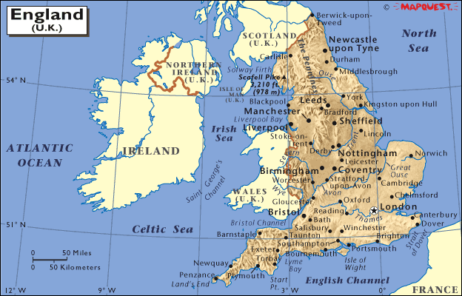
England

Slide 52
Why do people often use “England” and “English” to refer to “Britain” and “British”?
(2001 census)
Administrative Division Population Area Size
(sq km)
England 50,09 million 130,281
Scotland 5,08 million 13,576
Wales 2,95 million 77,925
Northern Ireland 1,71 million 20,732
UK total 59,8 million 242,514

Slide 53
Why do people often use “England” and “English” to refer to “Britain” and “British”?
England is the largest, most populous, and the richest.
Largeness Size Pop.
England biggest 60% 84%
Scotland 2nd largest 30% 10%
Wales smallest 9% 5%
British

Slide 54
讲义
Where is England?
England is in north-west Europe and is in the southern part of Great Britain. It is an island country and also part of the United Kingdom (UK) .
England is the largest country in Great Britain and the UK. It is sometimes, wrongly, used in reference to the whole United Kingdom, the entire island of Great Britain, or indeed the British Isles. This is not only incorrect but can cause offence to people from other parts of the UK. (Nationality of the British people).
Nearly 84% of the population of the UK lives in England, mainly in the major cities and metropolitan areas.
How far is England from mainland Europe?
England is only 35 km from France and is now linked by a tunnel under the English Channel.

Slide 55
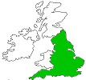

England: the size
England is 74 times smaller than the USA,
59 times smaller than Australia and
3 times smaller than Japan.
A little larger than Hunan Province in China
England covers over 50,000 square miles (130 439 square kilometres) and
is the largest of the countries comprising the island of Britain, covering about two-thirds of the island.
Nearly 84% of the population

Slide 56
No place in England is more than 75 miles (120 km)
from the sea.

Slide 57
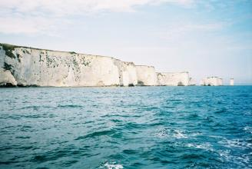
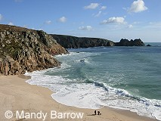
Coastline： a long coastline of 3,200 km
In the south and west,
The east coast
Steep cliffs
beaches

Slide 58
Coastline 讲义
England has a long coastline of 3,200 km. In the south and west, the coastline can be rocky, with steep cliffs. The east coast is often flat and low lying, with beaches and mud flats.

Slide 59
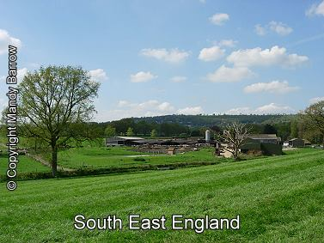
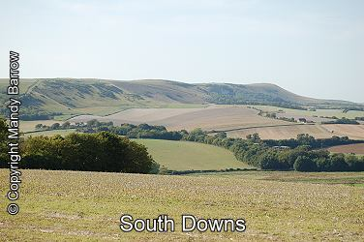
The landscape
The south of England is mostly low-lying land/lowland, with hills and agricultural land, meadowlands and pastures

Slide 60
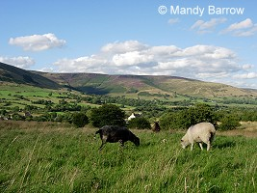

Slide 61
讲义
Much of the land in England is flat (low lying) - less than 1000m above sea level, forming meadowlands and pastures and less than 10 percent of the area is covered by woodlands. Farmers raise animals or grow crops in the fields

Slide 62
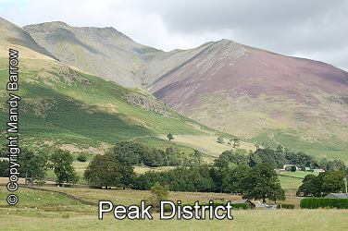
the north of England is mostly covered in moorland 高沼地，荒野and mountains

Slide 63
Highly urbanized
- % of population living in cities
-only % working in agriculture
Physically largest with largest population
84% population
Dominance in: size/ culture/ economy
80
2

Slide 64
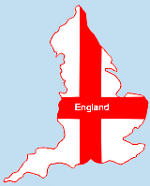
Why do people overseas take England for the UK
England is the biggest country in the UK
Occupies two thirds of Great Britain.
England contains about 84% of the UK population.
The capital of the UK is in England
The English language comes from England
The British Royal family live in England
Dominance in: size/ culture/ economy

Slide 65
讲义Why and how does England dominate the UK?
people may think that England is the UK or is Great Britain. This is of course is untrue, but is a common thought by many people overseas.
England is the biggest country in the UK
England is a country in the UK and occupies most of the southern two thirds of Great Britain. The total area of England is 130,410 sq km (50, 352 sq mi).
England contains about 84% of the UK population.
The capital of the UK is in England
The English language comes from England
The British Royal family live in England

Slide 66
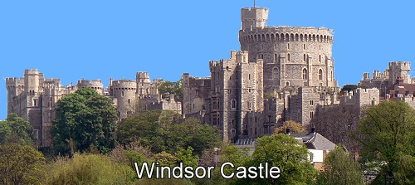
What is England famous for?
England is famous for its long history.
England is famous for its Royal Family.
England is famous for its Castles and Historic houses
England is famous for its educational institutes.
England is famous for William Shakespeare.
England is famous for its green hills and fertile lowlands.
England is famous for its rain and the lush green of its countryside
England is famous for some of the world’s greatest pop stars
England is famous for its pubs.
England is famous for many landmarks

Slide 67
What is England famous for? 讲义
England is famous for its long history.
England is famous for its Royal Family.
England is famous for its Castles and Historic houses
Windsor Castle is the oldest royal residence still in use.
England is famous for its educational institutes. It has some of the most famous universities of the world like Oxford, Cambridge and London universities.
England is famous for William Shakespeare. Hamlet,
Othello, and Romeo and Juliet were written by him.
England is famous for its green hills and fertile lowlands.
England is famous for its rain and the lush green of its countryside
England is famous for some of the world’s greatest pop stars - the Beatles, the Rolling Stones, David Bowie, Queen, Phil Collins, the Spice Girls and Oasis.
England is famous for its pubs. (English pubs are a part of everyday life here. They're pretty much a community gathering place. Many people go there to watch a football game, play pool or just have a beer.)
England is famous for many landmarks, such as Big Ben, Buckingham Palace
England is famous for the Lake District

Slide 68
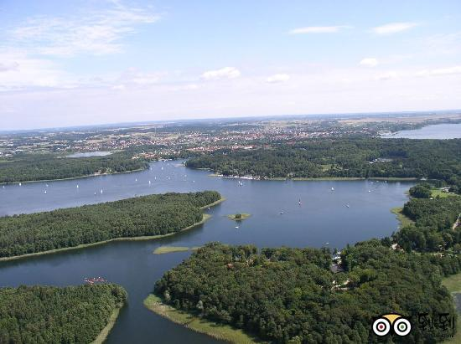
Lake District
a scenic spot in North West England
A popular holiday destination
being famous for its lakes and its mountains
its associations with the early 19th century poetry and writings of William Wordsworth and other poets.

Slide 69
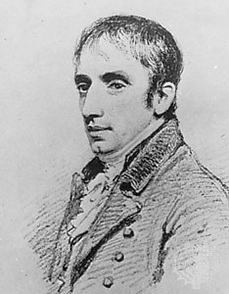
William Wordsworth
a romantic poet
appointed poet laureate in 1843
Living in the Lake district after
1797
（1770—1850）

Slide 70
England
A flatland country, also called Lowland zone
Pennines: the backbone of England
Lake district

Slide 71
英格兰 无解说 5M
https://www.bilibili.com/video/av16163827/?spm_id_from=333.788.videocard.29

Slide 72
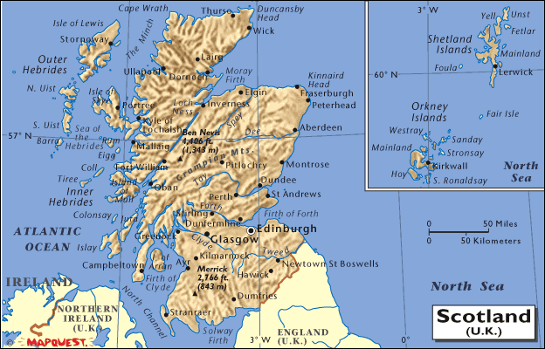
Scotland

Slide 73
讲义
Where is Scotland?
Scotland is in north-west Europe and is part of Great Britain, an island country ( See map ) and the United Kingdom (UK) .
Scotland is a mountainous country in the north of the island of Great Britain and shares a land border to the south with England and is bounded by the North Sea on the east and the Atlantic Ocean on the west. Its capital city is Edinburgh.
Scotland has some 790 islands - 130 inhabited.
Scotland is Famous for....
Its fresh water lochs (lakes) – there are over 600 square miles of them. One of the most famous is Loch Ness where a mysterious monster is said to lurk in the depths of the water.
It is also famous for its clans, kilts, medieval castles, as well as poetry and songs of Robert Burns.
Theatre lovers from around the world come to Edinburgh for its famous theatres festival.

Slide 74

Scotland
What comes to your mind when you think of Scotland?
In the north of
A mountainous country
three natural zones: The Highlands in the north
the central Lowlands
the southern Highlands
790 islands
130 inhabited

Slide 75
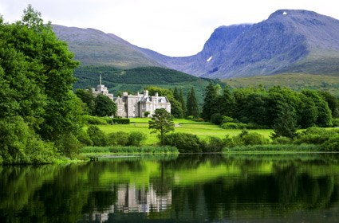
What is Scotland famous for?
Ben Nevis
(1 343 meters high)

Slide 76
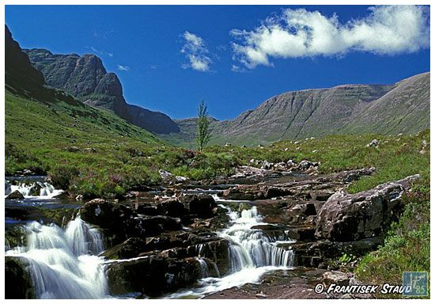
The highlands in Scotland：
sparsely populated, with many mountain ranges dominating the region, and including the highest mountain in the British Isles, Ben Nevis
The film: Brave Heart

Slide 77
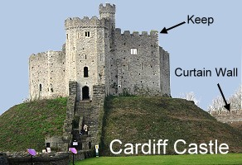
A country of castles
Why were castles built?
Where were the castles built?

Slide 78
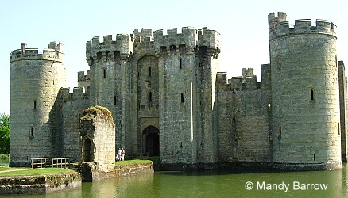

Slide 79
讲义
What are Castles?
A castles is a large strong building, built in the past by a ruler or important person to protect the people inside from attack. They were both a home and a fortress.
Why were Castles built?They were built to provide safety and protection from attack and to display the owner's rank and wealth.
Where were Castles built and why?
Castles were often built on hilltops or surrounded by water to make them easier to defend.
What is the biggest castle in England?
The biggest castle in England is Windsor Castle, one of the three homes of the Queen. It is said to be the largest inhabited fortress in the world.
What is the biggest castle in World?
The biggest castle in the world, at about 570 meters length and an average of about 130 meters wide, is Prague Castle, the castle in Prague.

Slide 80

the biggest castle in England
Windsor
the largest inhabited forthress in the world

Slide 81


Slide 82

the biggest castle in World： Prague Castle in Czech Republic 捷克共和国
570 meters in length and about 130 meters in width

Slide 83

A late 12th-century castle
http://www.primaryhomeworkhelp.co.uk/castles/index.html

Slide 84

Bodiam Castle

Slide 85

Airth castle
A 14th century castle ,
a spa and a Scottish castle accommodation ,
one of the most popular places for Scottish castle weddings.

Slide 86

Stirling castle
about 30 miles from Glasgow and 40 miles from Edinburgh
A long history,an important fortification and the site of many sieges and battles,
standing out for its imposing location and storied history

Slide 87

kilt
In Scotland the national dress is a kilt.((苏格兰传统男式) 短褶裙;
The kilt is worn around the waist.
【报信儿】男生也穿小裙子？苏格兰人民美滋滋 2M 中文解说 good
https://www.bilibili.com/video/av14056507/?spm_id_from=333.788.videocard.6

Slide 88



Slide 89
苏格兰 无解说 3M
https://www.bilibili.com/video/av32358237/?spm_id_from=333.788.videocard.13
苏格兰乡村舞 Scottish Country Dance(2:00-> good)
https://www.bilibili.com/video/av2576986?from=search&seid=15941584530564360856
苏格兰风笛名曲 2M
https://www.bilibili.com/video/av29241682/?spm_id_from=333.788.videocard.2
苏格兰高地警卫团游行穿过爱丁堡皇家英里大道 穿裙子的苏格兰士兵
https://www.bilibili.com/video/av25351611/?spm_id_from=333.788.videocard.24

Slide 90


Wales

Slide 91
讲义
Where is Wales?
Wales is in north-west Europe and is part of Great Britain, an island country ( See map ) and the United Kingdom (UK) .
The name Wales comes from the Cymraeg word Gwalia, meaning in English "Homeland". It later became Latinized as Walia, then by the Normans to something like Wal~es....then Wales.
Wales (Cymru in Welsh) is a mountainous country on the western side of Great Britain.
Wales is bordered by England to the east, the Bristol Channel to the south, St George's Channel in the west, and the Irish Sea to the north.
Technically, Wales is a principality. This means that it is ruled by a prince. Traditionally the Prince of Wales is the eldest son of the English monarch.

Slide 92
Wales
on the western side of Great Britain.
a mountainous country
taking up less than 9% of
the whole island.
5% of populatation
Welsh 威尔士语

Slide 93


Slide 94
最美威尔士】威尔士北部BEAUTIFUL NORTH WALES 无解说 3M
https://www.bilibili.com/video/av12000199/?spm_id_from=333.788.videocard.27

Slide 95

Northern Ireland
Smallest among the four nations in Britain
Mostly rural, low hills, beautiful lake in the south- west, rugged coastline
Festive people
jig

Slide 96
Just Dance 2016 - Irish Meadow Dance 02:35M good
https://www.bilibili.com/video/av28920805?from=search&seid=7292929424013972876

Slide 97


Slide 98

Giant’s causeway (巨人之路) (1)
The 8th Natural Wonder of the World (suburb of Belfast)，
Sixty million years ago

Slide 99

Giant’s Causeway（2）
- a stretch of basaltic rock pillars weathered to different heights and presenting a stepped surface on the north coast of Northern Ireland. 37,000columns formed by cooling lava.
- legend: Finn MaCool built it to cross the sea to Scotland

Slide 100


Giant’s causeway
Prodigious skills (鬼斧神工) of Nature:

Slide 101

list of natural wonders of world top 1

Slide 102

top 2

Slide 103

top 3
珠穆朗玛峰

Slide 104

极光，也被称为北极光 natural light

Slide 105
极光，也被称为北极光，是自然产生的光，在天空中创造出引人入胜的壮观景象。极光经常出现在地平线上。最令人惊奇的景象是当北极光出现在天空中时，它几乎就像灯光在跳舞。

Slide 106

伊瓜苏瀑布(IguazuFalls),位于南美洲巴西和阿根廷两国边境

Slide 107
https://www.wonderslist.com/top-10-natural-wonders-of-the-world/

Slide 108
Giant’s causeway
Prodigious skills (鬼斧神工) of Nature:

Slide 109
【TOP10】你确定不想知道北爱尔兰的10件事情么 双语字幕 8M good
https://www.bilibili.com/video/av14853519?from=search&seid=11802923217491963620

Slide 110
Top 10 about Northern Ireland
The famous people
The haunted house
The strangest laws about eggs and potato
The cuisine
The largest lake
Northern Island world records
The RMS Titanic & largest museum of Liners
Sunday bloody Sunday: massacre in London
The troubles in Ireland
Forming of Northern Ireland

Slide 111

Major cities
London
Edinburgh
Cardiff
Belfast

Slide 112
England - The capital is London.
Scotland - The capital is Edinburgh .
Wales - The capital is Cardiff.
Northern Ireland - The capital is Belfast.

Slide 113

World metropolis
世界大都市

Slide 114
【自制双字】并不是伦敦的伦敦城－The (Secret) City of London 5m
https://www.bilibili.com/video/av6001822/?spm_id_from=333.788.videocard.10

Slide 115


London
in the southeast of England.
33 boroughs市镇
Central London
City of London
the “Square Mile” 一平方英里
1.4 square mile(2.6 square kilometer)
the oldest part of London
financial center
City of London +32 boroughs = Greater London.大伦敦

Slide 116
讲义
London is in the southeast of England.
London is made up of two ancient cities which are now joined together.
They are:
London is formed by two ancient cities – City of London and City of Westminster, both cities forming the region of Greater London
the City of London, know simply as 'the City' which is the business and financial heart of the United Kingdom. It is also known as the Square Mile (2.59 sq km/1 sq mi). It was the original Roman settlement (ancient Londinium), making it the oldest part of London and already 1,000 years old when the Tower of London was built.
the City of Westminster, where Parliament and most of the government offices are located. Also Buckingham Palace, the official London residence of the Queen and the Royal family are located there too.
The whole area of Greater London was built around city of London

Slide 117
the City of Westminster
Political and religious center

Slide 118

Trafalgar Square (in 1805)

Slide 119
The West End
is London’s main entertainment (theatres) and shopping district.
The East End
formerlly centre of London'd docks and heavy industry
places of interests, markets

Slide 120
Districts of London
Central London
City of London (the "Square Mile")The City of London is the principal financial district not only of London, but of the UK and Europe. The City also has its own police force, the City of London police.
The West End
To the west and north of Trafalgar Square (to the west of City of London)is the West End, the main shopping and entertainment district in London. Most of London's major theatres are located here, as is the Royal Opera House.There are over 100 theatres in London, 50 of them are in the west end.
The East End ( The East End of London)
The East End was formerly the centre of London'd docks and heavy industry. The area was heavily bombed during World War Two(1939-45).
The East End has many of places of interest including many of London's markets, (for example Columbia Road Flower Market, Spitalfields Market, Brick Lane Market, Petticoat Lane Market).

Slide 121
facts about London
the biggest city in Britain and in Europe. 620 square miles

Slide 122



London Vs. Beijing
1577
square kilometers
16410.54
square kilometers

Slide 123
the highest population density in Britain :
About 4699/square kilometre

Slide 124

population density of
Beijing Jing

Slide 125

A. city of London
B. city of Westminster
C. West end
D. East end
The political center:
the City of Westminster (Downing street, Buckingham Palace)
the business and financial center
The city of London
The commercial ( shopping and entertainment) center:
the West End
The cultural center: London University (the biggest)
combining functions of New York, Washington & Los Angeles
One of the four leading cities in the world:
New York, Paris, Tokyo

Slide 126
目前全球十大金融中心城市排名
London, New York, Hongkong

Slide 127
世界第一大金融中心，与纽约和香港并称为“纽伦港”。 伦敦是英国的政治、经济、文化、金融中心，是全世界博物馆、图书馆和体育馆数量最多的城市。有19家世界500强总部和7座世界排名前100的大学位于伦敦。伦敦的伦敦大学学院世界排名第8、帝国理工大学世界排名第9、伦敦政治经济学院世界排名第27、伦敦国王学院世界排名第33。
伦敦是一座全球领先的世界级城市，是全球最富裕、经济最发达、商业最繁荣、生活水平最高的城市之一，在政治、经济、文化、教育、科技、金融、商业、体育、传媒、时尚等各方面影响着全世界，是全球化的典范。
伦敦是世界第一大金融中心，控制着全世界45%的外汇交易和黄金、白银、原油等大宗商品定价权，也是全球最大的银行、保险、期货和航运中心。伦敦平均每日的外汇交易额高达2.7万亿美元，为世界第一，居民财富总额位居世界第二。

Slide 128
facts about London
is the seat of central government in Britain.
has 43 universities
the first city in the world to have an underground railway, known as the 'Tube'.
Beijing 92, 8-985,27-211

Slide 129
facts about London讲义
London is the biggest city in Britain and in Europe.
London occupies over 620 square miles
London has a population of 7,172,036 (2001)
About 12 per cent of Britain’s overall population live in London
London has the highest population density in Britain, with 4,699 people per square kilometre,
London is the seat of central government in Britain.
The tallest building in London is the Canary Wharf Tower.
London was the first city in the world to have an underground railway, known as the 'Tube'.
There are over 100 theatres in London, including 50 in the West End. London theatre accounts for 45% of all UK theatre admissions and over 70% of box-office revenues. Source: GLA Economics
London has 43 universities, the largest concentration of higher education in Europe.

Slide 130


Facts about London Transport
the oldest underground railway network in the world. in 1863
The railways came to London in Victorian times.
'the Tube’.
55%
named after pubs:
Elephant & Castle, Angel, Swiss Cottage, Royal Oak and Manor House.

Slide 131


icon of London
The double-decker bus
The black cab

Slide 132
讲义
Facts about London Transport
The London Underground is the oldest underground railway network in the world.
The London Underground, was built in 1863, and was the first metro 地下铁道of the world.
The London Underground is known as 'the Tube’.
55% of the London Underground, is not underground.
Five stations on the Underground system are named after pubs: Elephant & Castle, Angel, Swiss Cottage, Royal Oak and Manor House.
Angel Tube Station, has Western Europe’s longest escalator with 318 steps.
The British Transport Police are responsible for police services on National Rail and London Underground services.
The double-decker bus is an icon of London
The traditional colour of taxis in London is Black. Today the 'Black Cabs' come in 12 different colours.
London's distinctive taxis, black cabs, are as much a feature of city life as its red double-decker buses.
Like the buses, black cabs are also being modernised and many are now painted other colours with advertising.

Slide 133
Landmarks of London

Slide 134

The London Eye
the largest Ferris wheel in Europe
a height of 135 meters (443 ft),
the most popular paid tourist attraction in the United Kingdom
How many people can it carry?
How long does a ride last?
How much does it cost to go on the London Eye?

Slide 135
讲义
What is the London Eye?
The London Eye is a giant Ferris wheel.
How big is it?
The London Eye (previously known as the Millennium Wheel) stands 135 metres (443 feet) high.
How many people can it carry? How long does a ride last?
The London Eye can carry 800 passengers at a time on a thirty-minute ride. From its highest point of 450 feet, it promises views of up to 25 miles.
How much does it cost to go on the London Eye?
Adult Ticket from £18.80(166RMB)

Slide 136


Slide 137
Buckingham Palace
(in1703-1705)
in 1761
in 1837
The Queen's official London residence
Buckingham Palace has rooms.
These include 19 State rooms, 52 Royal and guest bedrooms, 188 staff bedrooms, 92 offices and 78 bathrooms.
775
Forbidden City
over 8700

Slide 138
讲义
One of famous tourist attraction
Buckingham Palace is The Queen's official London residence
Buckingham Palace has 775 rooms. These include 19 State rooms, 52 Royal and guest bedrooms, 188 staff bedrooms, 92 offices and 78 bathrooms.
Buckingham Palace gets its name from a man named Duke of Buckingham. He built Buckingham House for himself as a grand London home.
In 1761, George III bought Buckingham House for his wife, Queen Charlotte.
The first monarch to use Buckingham Palace as their official residence was Queen Victoria, who moved there in 1837.
Over 800 members of staff are based at Buckingham Palace. Their jobs range from housekeeping to horticulture, catering to correspondence. Some of the more unusual jobs include fendersmith, clockmaker and flagman.

Slide 139
Palace of Westminster
威斯敏斯特宫
议会大厦

Slide 140

the largest Gothic building
the largest Gothic building

Slide 141
How many rooms?
over 1,000 rooms and in it.
Has over 1,000 rooms, 100 staircases, 11 courtyards, eight bars and six restaurants, two miles of corridors - none of them open to the public.
The symbol of in the UK
politics

Slide 142
the largest Gothic building in the world
over rooms and in it.
Has over 1,000 rooms, 100 staircases, 11 courtyards, eight bars and six restaurants, two miles of corridors - none of them open to the public.
built in the mid-19th century.
The symbol of in the UK
The Palace of Westminster contains the bell Big Ben.
1,000
politics

Slide 143
讲义
The modern Palace of Westminster is the largest Gothic building in the world - there are over 1,000 rooms and two miles of corridors in it.
The Houses of Parliament has 1,000 rooms, 100 staircases, 11 courtyards, eight bars and six restaurants - none of them open to the public.
The Houses of Parliament are part of the greater Palace of Westminster, built by Barry and Pugin in the mid-19th century.
The symbol of politics in the UK
The Palace of Westminster, known also as the Houses of Parliament or just Westminster, is where the two Houses of the Parliamentof the United Kingdom (the House of Lords and the House of Commons) conduct their sittings. It is the place where laws governing British life are debated and passed.
The Palace of Westminster contains the bell Big Ben.

Slide 144

Big Ben
the largest four- faced chiming clock,
the third-tallest free-standing clock tower in the world,
St Stephens Tower

Slide 145

the 13-ton bell inside the clock.
Chimes every 15 minutes
for a radius of up to 5 miles

Slide 146
讲义
Big Ben is not actually the name of the clock or the tower. It is the 13-ton bell inside the clock.
The tower is known as St Stephens Tower but most people refer to it as Big Ben.
What is Big Ben?
Big Ben is one of the most famous landmarks in the world. It is the clock tower. The name Big Ben is often used to describe the clock tower that is part of the Palace of Westminster.
Officially "Big Ben" does not refer to the clock tower but instead to the huge thirteen ton Great Bell located at the top of the 320-foot-high tower.

Slide 147
讲义
Where is Big Ben located?
Big Ben is situated on the banks of the River Thames on the north side of the Houses of Parliament in Westminster, London.
How heavy is Big Ben bell?
The Big Ben bell has the following measurements:
9'-0" diameter, 7'-6" high, and weighs 13 tons 10 cwts 3 qtrs 15lbs (13,760 Kg)
When can we hear the bell ring?
Big Ben chimes every 15 minutes and the sound can be heard for a radius of up to 5 miles.

Slide 148

Since 1894
244 meters
Iconic symbol of London
标志性标志

Slide 149


Slide 150
讲义
Where does the Tower Bridge stand (over which river)?
Tower Bridge has stood over the River Thames in London since 1894 and is one of the finest, most recognisable bridges in the World. It is the London bridge you tend to see in movies and on advertising literature for London.
an iconic symbol of London
Carries– motor vehicles, cyclists, pedestrians

Slide 151
Why is the Tower Bridge special?
Tower Bridge is the only Thames bridge which can be raised.

Slide 152
讲义
The middle section can be raised to permit large vessels to pass the Tower Bridge. Massive engines raise the bridge sections, which weigh about 1000 tons each, in just over a minute. It used to be raised about 50 times a day, but nowadays it is only raised 4 to 5 times a week
Tower Bridge is the only bridge over the Thames that can be raised as it is a combined bascule (drawbridge) and suspension bridge. This means that the middle section of the bridge can be raised to allow river traffic to pass through.
There have been several incidents on the bridge over the years. In December 1952, the bridge opened while a number 78 doubledecker bus was on it

Slide 153

Tower Bridge is 60 meters long with towers that rise to a height of 43 meters.

Slide 154

London Bridge: 1176

Slide 155
讲义
London Bridge is between the City of London and Southwark. It is between Cannon Street Railway Bridge and Tower Bridge. London's original bridge made this one of the most famous bridge in the world.
The first London Bridge is thought to have been built by the Romans sometime in the first century, with several rebuilds over the centuries. Eventually wooden bridges were replaced with a stone bridge, the first one being started in 1176 and finished years later

Slide 156

Westminister Abbey
a large, mainly Gothic church, in Westminster, London
the traditional place of coronation加冕礼 and burial site for monarchs of Commonwealth Realms

Slide 157

Trafalgar square
a square in central London
a tourist attraction

Slide 158

an Anglican cathedral
the seat of the Bishop of London
圣公会大教堂
伦敦主教所在地
one of London's most famous and most recognisable sights
ST Paul’s Cathedral

Slide 159
There are so many Scenic Spots and Historical Sites, tourist attractions in London. You have to spend at least 7 days touring London.

Slide 160
伦敦：历史与活力【英语英字】 英字 24M royal pageantry very good
https://www.bilibili.com/video/av8664582/?spm_id_from=333.788.videocard.12
London： 中文解说 24M https://www.bilibili.com/video/av4048058/?p=5
London风景 无解说 6M
https://www.bilibili.com/video/av16163827/?p=2

Slide 161

Edinburgh
the capital city of Scotland
like Rome, was built on seven hills.
economic center of Scotland
a tourist city second only to London in U.K.

Slide 162

The new city of Edinburgh

Slide 163


Slide 164


Slide 165


Slide 166

Edinburgh castle

Slide 167

Castles in Ediburgh
Edinburgh castle

Slide 168
Edinburgh castle
The symbol of Edinburgh
situated on a mound of volcanic rock 火山岩丘one of Scotland's oldest castles, unequalled in the whole of the British Isles
a remarkable fortress, the historical interest of and former royal residence,
visited annually by approximately one million people
No visit to Edinburgh is complete without a visit to Edinburgh Castle

Slide 169
a cultural city，holding an international festival of music and the arts every year

Slide 170
在爱丁堡|At Edinburgh 3M
https://www.bilibili.com/video/av29219427/?spm_id_from=333.788.videocard.3
爱丁堡 风光 4M
https://www.bilibili.com/video/av22007652?from=search&seid=1265606724488342926

Slide 171
爱丁堡国际军乐节开幕式 7M good
https://www.bilibili.com/video/av324277/?spm_id_from=333.788.videocard.14
纪录片.爱丁堡军乐节.2018[高清][英字]
https://www.bilibili.com/video/av30517125/?spm_id_from=333.788.videocard.1
纪录片.爱丁堡军乐节.2017[高清][英字] 50M
https://www.bilibili.com/video/av13940904/?spm_id_from=333.788.videocard.6

Slide 172



Cardiff
The capital city of Wales
A port

Slide 173



Belfast
The capital of Northern Ireland
An industrial seaport
Belfast city hall
the wheel of Belfast

Slide 174


Liverpool
The second largest port of England
A metropolitan city

Slide 175
Climate of Britain
1. Features of Britain’s climate
No climate
“Other countries have a climate; in England we have weather.”
The statement is often made by Englishmen to describe the peculiar meteorological 气象的conditions of their country.
A typical maritime/oceanic climate

Slide 176
1)rainy---abundant rainfall
  The uncertainty about the weather tends to make the Englishmen cautious.
“A foreigner may laugh when he sees the Englishman setting forth on a brilliantly sunny morning wearing a raincoat and carrying an umbrella, but he may well regret his laughter later in the day!”

Slide 177
rainfall
  1)a steady reliable rainfall throughout the year
  2)uneven distribution of rain
    A. a water surplus in the north and west
    B. a water deficit in the south and east

Slide 178
Rain or overcast skies can be expected for up to 300 days each year. that’s why so much of the countryside is lush and green. The average annual rainfall in Britain is over 1000mm. There are more rainy days but less sunny days. The rainfall is not heavy. In some places there are over 260 rainy days a year.

Slide 179
2)changeable and unpredictable, no clear cut of 4 seasons
“In no country other than England, it has been said, can one experience four seasons in the course of a single day! Day may break as a balmy spring morning; an hour or so later black clouds may have appeared from nowhere and the rain may be pouring down. At midday conditions may be really wintry with the temperature down by about eight degrees or more centigrade. And then, in the late afternoon the sky will clear, the sun will begin to shine, and for an hour or two before darkness falls, it will be summer.”

Slide 180
3) Mild: no extremes
In England one can experience almost every kind of weather except the most extreme.
temperature: 4-6℃ in winter, 14-30℃ in summer (typical oceanic climate)
London
Spring:4～10 ℃ ，summer:11～20 ℃ ，autum:11～19 ℃ ，winter:4～9 ℃

Slide 181
Spring(March-May):4～10 ℃ ，
summer (June-August ):11～20 ℃
Autumn (September- November):11～19 ℃
winter(December-February):4～9 ℃
the best months to travel in England
May, June, September and October

Slide 182
Probably the best months to travel in England are May, June, September and October. These months generally have the most pleasant temperatures and less rain. July and August are the warmest months, but they are also the wettest. The sunniest parts of the Britain are along the south coast of England.

Slide 183
spring flowers
春季（3-5月）
春季阳光明媚，天气晴好，有时也会有阴雨天。气温在6-11度之间。5月春风和煦，非常暖和，气温最高可达18度。
summer on the beach
夏季（6-8月）
夏季以晴热天气为主，但傍晚较为凉爽。平均气温约14-30度，偶尔出现35度高温天气。
autumn colours
秋季（9-11月）
秋天是寒暑交替的季节，时暖时冷，气温在7-18度之间，但初秋（9月）要比深秋（11月）暖和得多。
winter scene
冬季（12-3月初）
英国冬季有最短的日照（约7-8个小时）和最冷的天气，但这样的日子往往有清新的空气和明媚的阳光。气温在1-5度之间。
The division of seasons in London is the same as that in Beijing. We have spring from March to May. Summer is from June to August. Autumn is from September to November. Winter is from December to February.

Slide 184
冬无严冬，夏无酷暑

Slide 185
Foggy？
The city of fog
Oliver Twist
Published in 1838

Slide 186
伦敦曾经是出了名的雾都。从19世纪未期每年90天左右减少至不到10天，到1980年，其“雾日”降到了5天。现在只有偶尔在冬季或初春的早晨才看到薄雾。
London used to be a famous fog city. From about 90 days per year in the late 19th century to less than 10 days, the "fog days" dropped to five days in 1980. Haze is now seen only occasionally in winter or early spring mornings.

Slide 187
Factors influencing the climate
  the surrounding waters
  the prevailing south-west winds
  the North Atlantic Drift (warm current)
  北大西洋暖流

Slide 188

Summary of
Climate and Weather
mild
cool

Slide 189
请随身携带一些轻薄衣物以及方便穿脱的衣服，至少要带一件御寒衣物以及一件防水外套或一把雨伞
Please take some light clothes and easy-to-wear clothes with you, at least one cold-proof clothes, a waterproof coat or an umbrella. No matter what kind of weather you meet, you will be safe with them.

Slide 190
讲义
Britain is an island country and the surrounding sea gives England a varied climate. We never know what the weather will be like from one day to the other. It can be sunny one day and rainy the next. As we have such a variable climate changing from day to day, it is difficult to predict the weather. In general we have warm summers and cool winters. Our summers are cooler than those on the continent, but the winters are milder.
Temperate Climate
The overall climate in England is called temperate maritime. This means that it is mild with temperatures not much lower than 0ºC in winter and not much higher than 32ºC in summer. It also means that it is damp and is subject to frequent changes.

Slide 191
The People
1. Population of Britain: characteristics
1)Densely populated
The most densely populated area: England
The least populated area: Northern Ireland
2)Highly urbanized
90% of the population is urban and only 10% rural
3)Unevenly distributed
The population is made up mainly of (composition of British population)
2.Different ancestors
  1)the English----the Anglo-Saxons
  2)the Scots, Welsh, and Irish----the Celts

Slide 192
Ethnicity 种族
Anglo-Saxons
Celtic people
immigrants

Slide 193
Population
The total population: about 62 000 000 (2009)
Highly urbanized: 90% living in cities and 10% living in the countryside
The most densely populated area: England
The least populated area: Northern Ireland
A multiracial society which produces a population of which 1 in 20 are of non -European ethnicity.
The official language: English

Slide 194


Slide 195
English Accent 英国腔
  1)Southerners speak the type of English closer to BBC English(伦敦音)
  2)Northerners speak broader English

Slide 196
Differences in speech between southern and northern England
  1)Southerners speak the type of English closer to BBC English(伦敦音)
Generally speaking, southerners speak the type of English closer to BBC English. They do not have a special accent except the Cockneys from the East End of London.
  2)Northerners speak broader English
However, the northerners speak broader English than the southerners, and often leave out the article “the” and the possessive adjectives “my”, “your”, “their”, etc.

Slide 197
English Accent
英音宝典！这17种口音都叫“英国腔”！ 双字幕 5M good
https://www.bilibili.com/video/av21598483/?spm_id_from=333.788.videocard.1
苏格兰英语 天气预报
https://www.bilibili.com/video/av23894132?from=search&seid=14091386472502495404
英国皇室腔 天气预报
https://www.bilibili.com/video/av10667881/?spm_id_from=333.788.videocard.0

Slide 198
Other Languages
Welsh 威尔士语
Gaelic 盖尔语

Slide 199
讲义
If you visit Scotland or Wales or Northern Ireland, you can not understand their language, don’t feel frustrated, because it is likely that the language they speak is not English at all. They speak Welsh in Wales. In Wales, their first language is Welsh. The second language is English. In Scotland or Northern Ireland, people may speak Gaelic.

Slide 200
英国的河流与湖泊 2M good
https://www.bilibili.com/video/av7719998/?spm_id_from=333.788.videocard.29

Slide 201
Rivers and Lakes
Important role of rivers in a country(?)
1. Important Rivers
  the Severn River
    the longest in the country
    only 338 kilos long
  the River Thames
    the 2nd longest
    the most important river
    336 kilos long
    Oxford and London are on the river
  River Clyde
    the most important in Scotland

Slide 202

The longest river
in England:
River Severn
（220 miles，354 km)
NEW SEVERN BRIDGE: the longest bridge in the UK,
connecting Wales and England

Slide 203
An important river in Britain:
River Thames
the second longest river in the United Kingdom and the longest river entirely in England
best known for flowing through central London
its strategic position at the centre of many events in British history
a major leisure area supporting tourism and pleasure outings as well as the sports of rowing, sailing.
a special appeal to writers, artists, musicians and film-makers and is well represented in the arts
many riverside attractions:

Slide 204


Slide 205
Palace of Westminster
威斯敏斯特宫

Slide 206
Tower Bridge
Iconic symbol of London
标志性标志

Slide 207
Description of River Thames by T.S.Eliot(1888-1965)
  Sweet Thames run softly, till I end my song.
  The river bears no empty bottles, sandwich papers,
  Silk handkerchiefs, cardboard boxes cigarette ends
  Or other testimony of summer nights.
and
  The river sweats
  Oil and tar
  The barges drift
  With the turning tide
  Red sails
  Wide
  To leeward, swing on the heavy spar,
  The barges wash
  Drifting logs
  Down Greenwich reach
  Past the Isle of Dogs

Slide 208
Lakes
Lough Neagh
The largest lake in Britain
Lake district
One of the most popular tourist attraction in Britain
The home of lake poets in 19th century

Slide 209
Mountains and Rivers
Pennines:
Chief mountain ranges: the Cambrians
the Grampiains
The Grampians: the largest mountain range in the UK

Slide 210

Ben Nevis: the highest mountain in the UK

Slide 211
Summary
Names
National flag
4 countries or kingdoms
England
Scotland
Wales
Northern Ireland
Major cities
Greater London
Landmarks of London
Weather features
People
English accents
Rivers and mountains

Slide 212
Exercises
The full name of the United Kingdom is ___ and ___.
The island of Great Britain is made up of ___, ___ and ___.
The United Kingdom has been a member of ___ since 1973.
Britain is now a ___ society which produces a population of which 1 in 20 are of ___ ethnicity.
London plays a significant role in ___ economic and cultural life. It’s not only the financial ___ of the nation, but also one of the ___ major international financial centers ___.
The highest mountain in Britain is___
_____flows through central London and it is a very important river.
____is the capital of Scotland.

Slide 213
Answers
The United Kingdom of Great Britain
the Northern Ireland
England, Scotland, Wales
European Union
Multiracial, non-European
Britain’s, center, three, in the world
Ben Nevis
Thames river
Edinburgh

